Slide 1

Modelling of anime scores on MyAnimeList
Project 2
Metis Data Science Bootcamp
By Ouyang Yingzhao
Photo by Tim Mossholder on Unsplash

Slide 2

Objectives
Based on features of an anime listing on MyAnimeList (MAL), predict its overall user score
The resultant model would indicate what features of an anime (e.g. episode length, genre) might influence its perceived quality (i.e. overall user score)

Slide 3
Methodology
Data retrieval
Data preparation
Feature selection
Model fitting and selection

Slide 4


Data retrieval
Obtained via
web scraping
Total dataset
16,706
Retrieved in 335 batches of 50 between 23 and 24 April 2020

Slide 5
Data retrieval
Total dataset
16,706
DROPPED

Slide 6

Data retrieval
With scores
11,541
DROPPED
Imported into

Slide 7
List of initial features
No | Feature | Description
1 | Type | TV, Movie, OVA, ONA, Music, Special, Other
2 | Status | Finished Airing, Currently Airing, Not yet aired
3 | Duration | Number of minute per episode
4 | Episodes | Number of episodes
5 | Rating | 5 ratings from “G – All” to “Rx – Hentai”, and “None”
6 | Members | How many MAL members have it on their lists
7 | Favorites | How many MAL members have it on their favourite list
8 | Started | Date that anime started
9 | Ended | Date that anime ended
10 | Voters | How many MAL members gave the anime a score
11 | Genres | Which genre(s) the anime is in; 42 total
12 … 19 | Adaptation … Prequel | What associated properties (adaptations, sequels, side-stories, prequels etc) the anime has; 8 features total

Slide 8


Data preparation
Dropped NaN data
Shows that have not finished airing
Shows with no start date
Cleaned NaN data
E.g. Movies with NaN episodes → 1 episode
Treated categorical data and added counts
Transformed features with log10, nested log10, sqrt
Clipped episodes and duration, multiplied to get clipped length
Visualised with

Slide 9


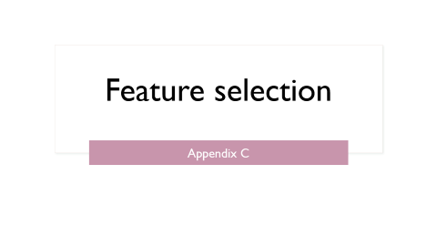
Feature selection
Using t-scores of OLS from statsmodel
P(t-score) threshold = 0.05
Using LASSO from scikit-learn
lambda = 0.01
parameter threshold = 0.01
Using metrices such as R² and MSE
Using intuition and domain knowledge

Slide 10
Feature selection: final list
No | Feature | Description
1 | Log age | Log10 of how long ago the anime was released in years
2 | Rating score | Numerical ranking of the rating for the anime (from G to Rx)
3 | Log genre count | Log10 of the number of genres associated with the anime
4 | Log length | Log10 of the clipped length of the anime (clipped duration multiplied by clipped episode counts)
5 | Log associated count | Log10 of the total number of properties associated with the anime
6 | Log log members | Total number of members with the anime on their list, log10 twice
7 | Log fav over log members | Log10 of number of members with the anime on their favorite list, as a proportion of the log10 of number of members with the anime on at least one of their lists
8 | Prequel count | How many prequels the anime has
9 | Parent story count | How many parent stories the anime has
10 | Special type | Whether the anime is a special (e.g. Christmas special)
11 | Music type | Whether the anime is a music video

Slide 11


Model selection
Models | Metrices
Linear Regression LASSO Ridge 5-fold cross validation performed on all models | R² Mean squared error (MSE) Mean absolute error (MAE) Max error

Slide 12
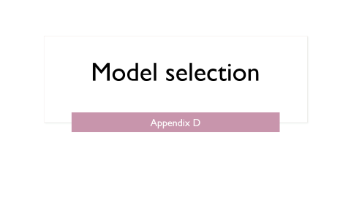
Model selection
 | Linear Regression | LASSO (lambda = 0.001) | Ridge
R² | 0.66 | 0.66 | 0.66
Mean squared error | 0.26 | 0.26 | 0.26
Mean absolute error | 0.38 | 0.38 | 0.38
Maximum error | 4.84 | 4.82 | 4.83
LASSO is marginally better than Ridge and LR

Slide 13
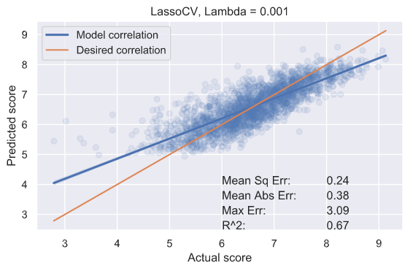
Test results

Slide 14
Observations
Model appears robust enough to indicate whether an anime may receive a high or middling rating
Model has a negative skew
Biased towards higher ratings for scores < 5, and towards lower ratings for scores > 8
Model has a high spread
Especially the case for lower scores

Slide 15
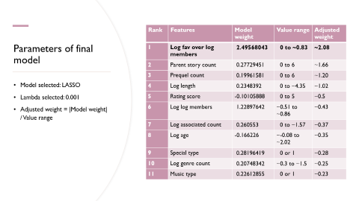
Observations
Rank | Features | Adjusted weight
1 | Log fav over log members | ~2.08
2 | Parent story count | ~1.66
3 | Prequel count | ~1.20
4 | Log length | ~1.02
5 | Rating score | ~0.5
6 | Log log members | ~0.43
7 | Log associated count | ~0.37
8 | Log age | ~0.35
9 | Special type | ~0.28
10 | Log genre count | ~0.25
11 | Music type | ~0.23
Features linked to favorites appear to be the most important…
…followed the number of parent stories or prequels, as well as total length

Slide 16
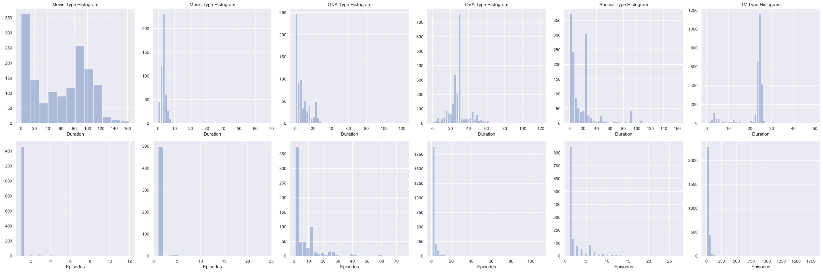
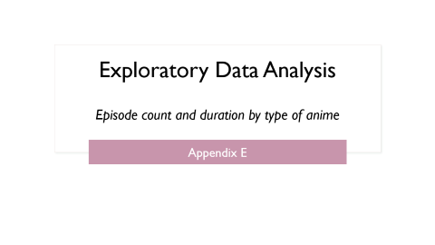
Observations
Different types of anime (TV, Movie etc.) have very different distributions for both episode duration and number of episodes
Could break down further into different genres

Slide 17
Next Steps
Can apply linear regression models to each type of anime separately
More sophisticated models need to be tested

Slide 18

Thank you for your attention
Photo by Bruce Tang on Unsplash
Any questions?

Slide 19
Data preparation in detail
Appendix A

Slide 20
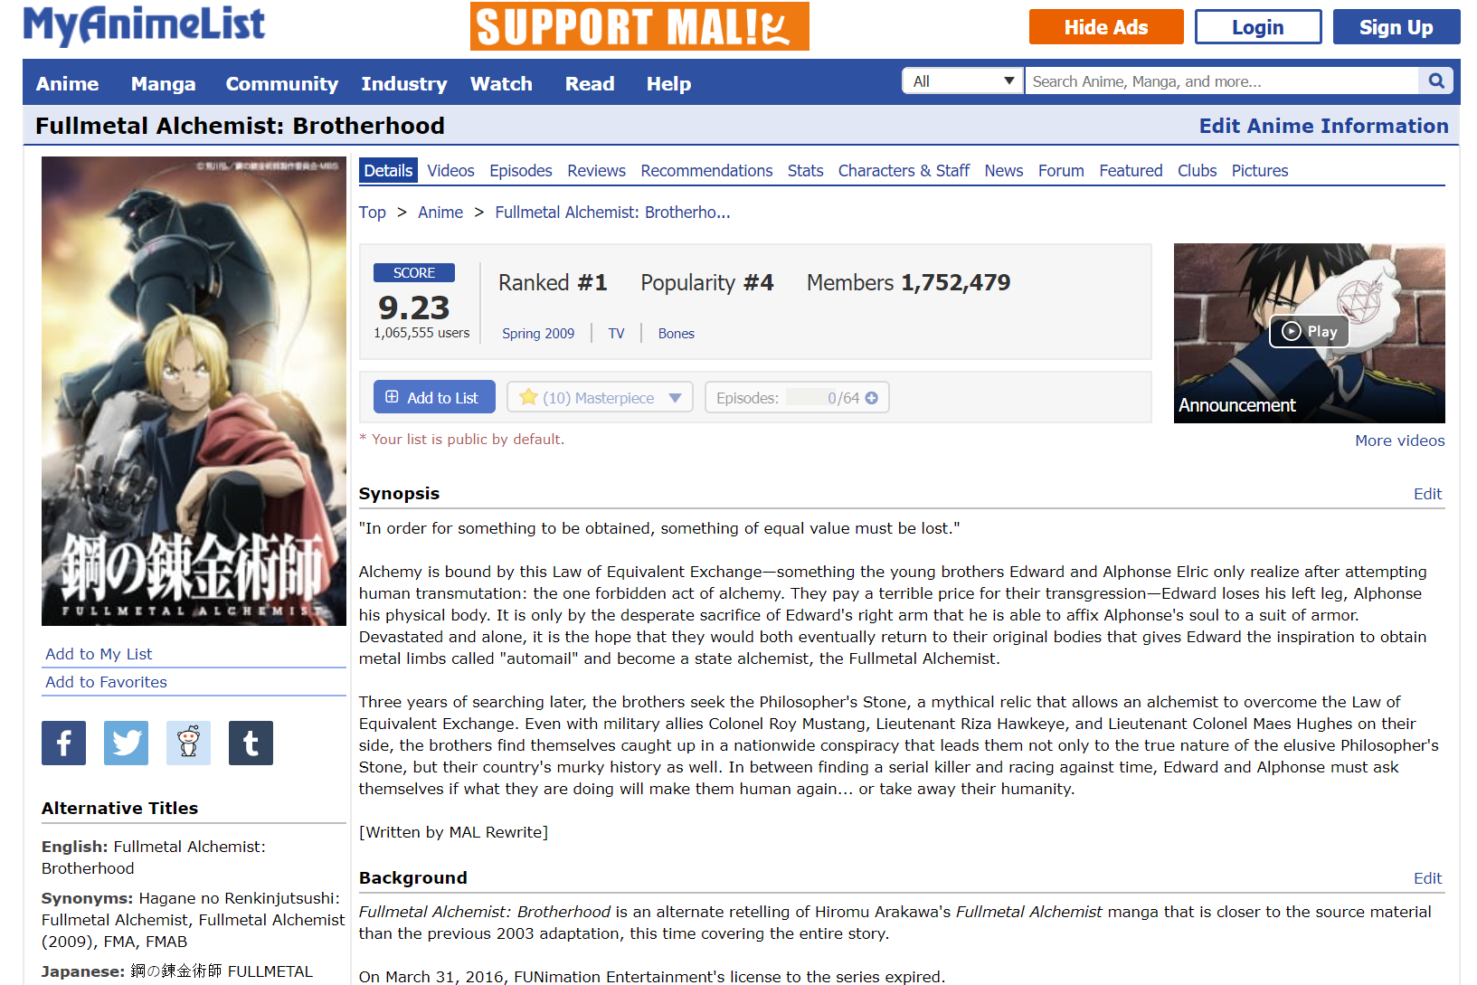
Example of MAL listing

Slide 21
Data cleansing
Limited data further
Dropped shows that have not finished airing
Dropped shows with no start date
Cleaned NaN data
Movies with NaN episodes → 1 episode
150 shows currently airing or not yet aired
7 shows

Slide 22

Categorical features
Genres → dummy variables
Consolidated into 10 total including ‘Other’
Type → dummy variables
7 total including ‘Other’
Rating → values based on restrictiveness of rating
0 for G, 5 for Hentai
None ratings assigned to PG, the most common rating

Slide 23
Categorical features
Included counts for genres
Included counts for associated columns
Included overall associated count

Slide 24
Feature transformation
Clipped episodes and duration to 60 and 150 respectively
Clipped length = clipped episodes X clipped duration
Started/Ended: assume 1st day of month if no day given; assume 1st January if no month given
Obtain year started, age of anime
Apply log10, nested log10, sqrt

Slide 25
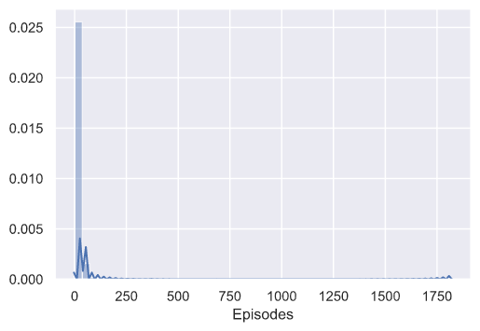
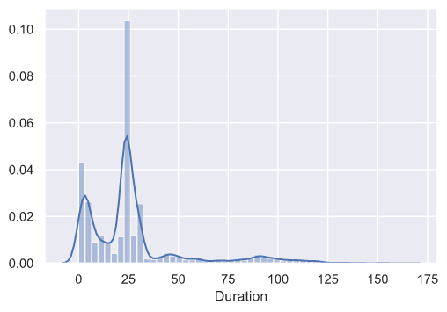
Episodes/Duration before clipping

Slide 26
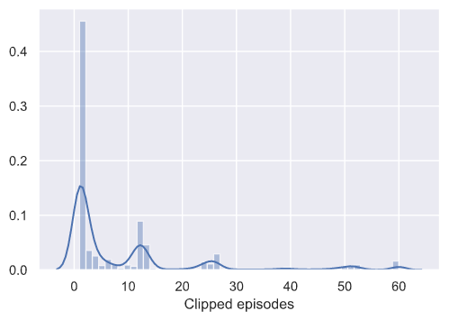
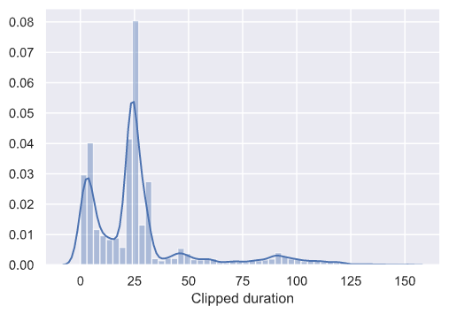
Episodes/Duration after clipping
Clipped at 60 episodes
Clipped at 150 minutes

Slide 27
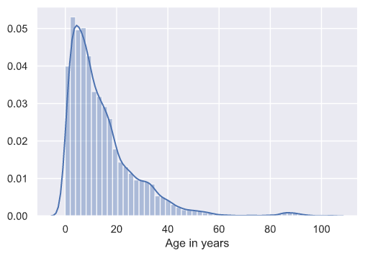
Example of feature needing log10 transformation

Slide 28
Categorical features
Appendix B

Slide 29
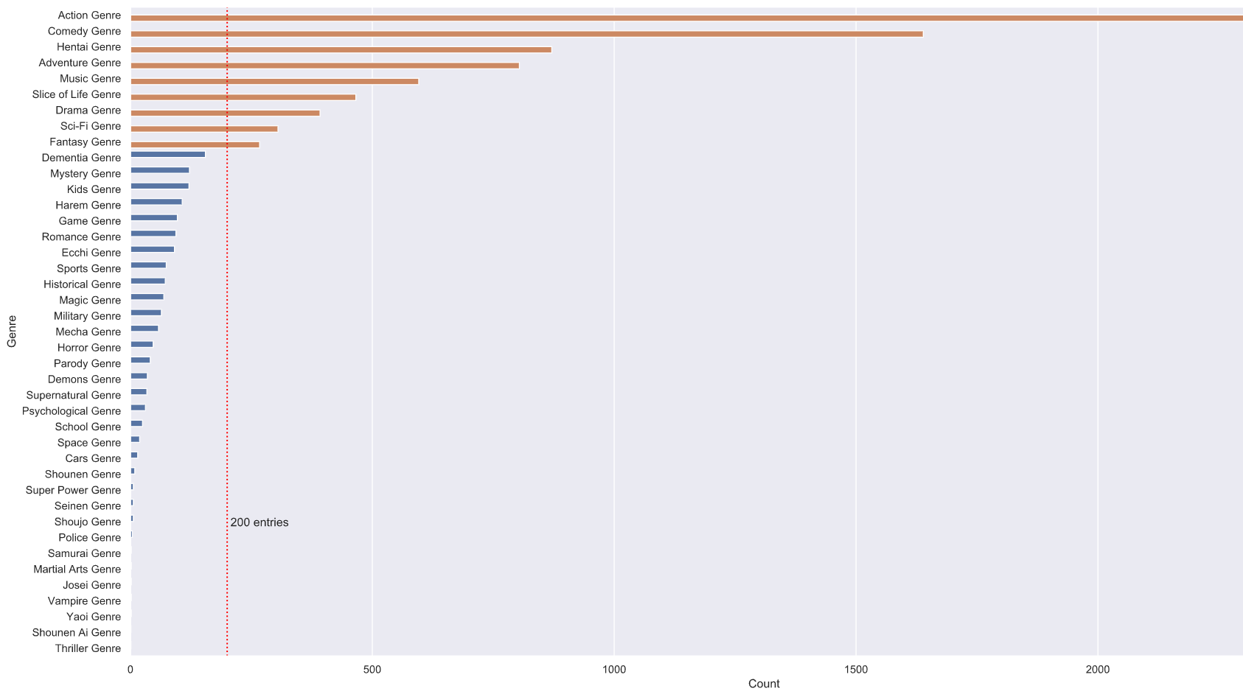
Full genre categories
41 genres in total
9 genres have >200 entries
Consolidate the rest into ‘Other’ (see next slide)

Slide 30
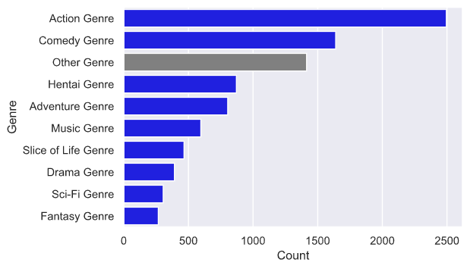
Consolidated genre categories

Slide 31
Rating: summary and conversion
Rating | Count | %age | Normalise to
G - All Ages | 1,878 | 21% | 0
PG - Children | 642 | 7% | 1
PG-13 - Teens 13 or older | 4,045 | 44% | 2
R - 17+ (violence & profanity) | 834 | 9% | 3
R+ - Mild Nudity | 703 | 8% | 4
Rx - Hentai | 968 | 11% | 5
None | 74 | 1% | 2 assume PG13
Total | 9,144 | 100% | -

Slide 32
Other categorical features
Type (6 total)
Associated (8 total)
 | Count | Proportion
TV | 2,850 | 31%
OVA | 2,259 | 25%
Movie | 1,494 | 16%
Special | 1,336 | 15%
ONA | 693 | 8%
Music | 512 | 6%
Total | 9,144 | 100%
Sequel
Alternative version
Adaptation
Prequel
Parent Story
Side Story
Spin-off
Other

Slide 33
Feature selection
Appendix C

Slide 34
List of initial features
No | Feature | Description | Used untransformed?
1 | Type | TV, Movie, OVA, ONA, Music, Special, Other
2 | Status | Finished Airing, Currently Airing, Not yet aired
3 | Duration | Number of minute per episode
4 | Episodes | Number of episodes
5 | Rating | 5 ratings from “G – All” to “Rx – Hentai”, and “None”
6 | Members | How many MAL members have it on their lists | √
7 | Favorites | How many MAL members have it on their favourite list | √
8 | Started | Date that anime started
9 | Ended | Date that anime ended
10 | Voters | How many MAL members gave the anime a score
11 | Genres | Which genre(s) the anime is in; 42 total
12 … 19 | Adaptation … Prequel | What associated properties (adaptations, sequels, side-stories, prequels etc) the anime has; 8 features total

Slide 35
List of transformed features
Original feature(s) | Transformation(s) applied | Transformed feature(s) | Count of transformed features
Duration | Clipped to 150 | Clipped duration | 1
Episodes | Clipped to 60 | Clipped episodes | 1
Clipped duration, Clipped episodes | Multiply | Clipped length | 1
Clipped duration, Clipped episodes, Clipped length | log10 | Log duration, Log episodes, Log length | 3
Rating | Assigned values | Rating score | 1
Members, Favorites | log10 and nested log10 | Log members, Log log members, Log favorites, Log log favorites | 4
Log members, log favorites | Divide | Log fav over log members | 1
Genres, Type | Dummy variables (consolidated genres less than 200 to Other) | XX Genre (10 total), XX Type (6 total) | 16
Genres, Associated columns | Count (including total associated), then apply log10 | Genre count, XX count (Associated, 9 total), Log genre count, log XX count (Associated, 9 total) | 20
Dummy variables, Clipped length | Multiply | XX Genre length (10 total), XX Type length (6 total) | 16
Dummy variables, Log length | Multiply | Log XX Genre length (10 total), XX Type log length (6 total) | 16
Started, Ended | Obtained age and year started; applied log and sqrt respectively | Age in years, Year started, Sqrt year started, Log age | 4
 |  | Total features used (including 2 untransformed features) | 86

Slide 36
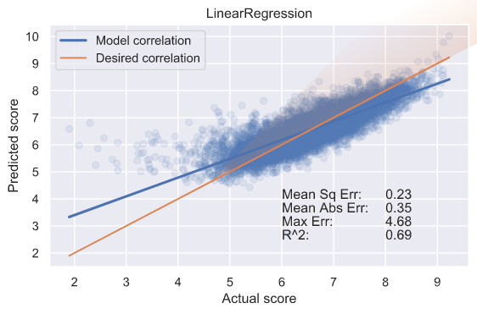
Test with all features
OLS and LASSO tests
LR test
Test | Result
R², adjusted R² | 0.70, 0.69
Skew | -1.257
Kurtosis | 8.749
Features with P(|t|) < 0.05 | 26
Collinearity | Strong
LASSO parameters > 0.01 for lambda = 0.01 | 8

Slide 37
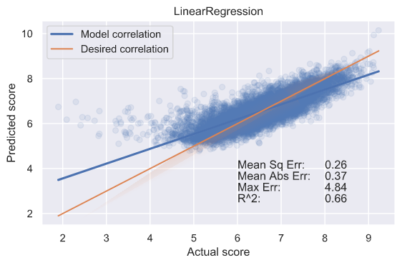
Test with 26 features (shortlisted by OLS)
OLS test
LR test
Test | Result
R², adjusted R² | 0.66, 0.66
Skew | -1.339
Kurtosis | 9.148
Features with P(|t|) < 0.05 | 23
Collinearity | Strong
LASSO parameters > 0.01 for lambda = 0.01 | 4

Slide 38
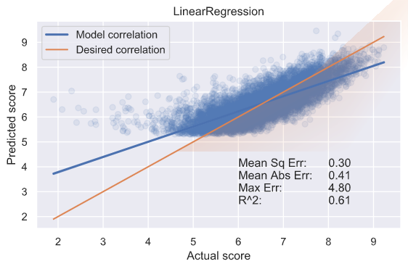
Test with 8 features (shortlisted by LASSO)
OLS test
LR test
Test | Result
R², adjusted R² | 0.61, 0.61
Skew | -1.075
Kurtosis | 7.440
Features with P(|t|) < 0.05 | 8
Collinearity | Weak
LASSO parameters > 0.01 for lambda = 0.01 | 8

Slide 39
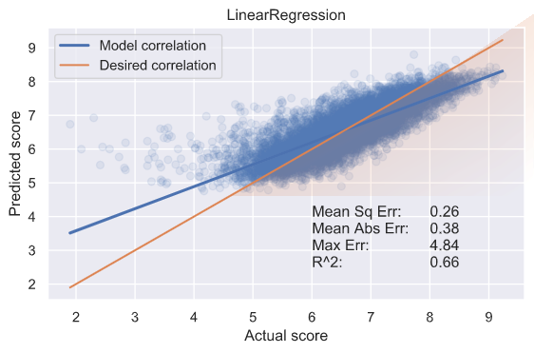
Test with final features (11)
OLS test
LR test
Test | Result
R², adjusted R² | 0.66, 0.66
Skew | -1.159
Kurtosis | 8.135
Features with P(|t|) < 0.05 | 12
Collinearity | Weak
LASSO parameters > 0.01 for lambda = 0.01 | 7

Slide 40
Final features
No | Feature | Description
1 | Log age | Log10 of how long ago the anime was released in years
2 | Rating score | Numerical ranking of the rating for the anime (from G to Rx)
3 | Log genre count | Log10 of the number of genres associated with the anime
4 | Log length | Log10 of the clipped length of the anime (clipped duration multiplied by clipped episode counts)
5 | Log associated count | Log10 of the total number of properties associated with the anime
6 | Log log members | Total number of members with the anime on their list, log10 twice
7 | Log fav over log members | Log10 of number of members with the anime on their favorite list, as a proportion of the log10 of number of members with the anime on at least one of their lists
8 | Prequel count | How many prequels the anime has
9 | Parent story count | How many parent stories the anime has
10 | Special type | Whether the anime is a special (e.g. Christmas special)
11 | Music type | Whether the anime is a music video

Slide 41
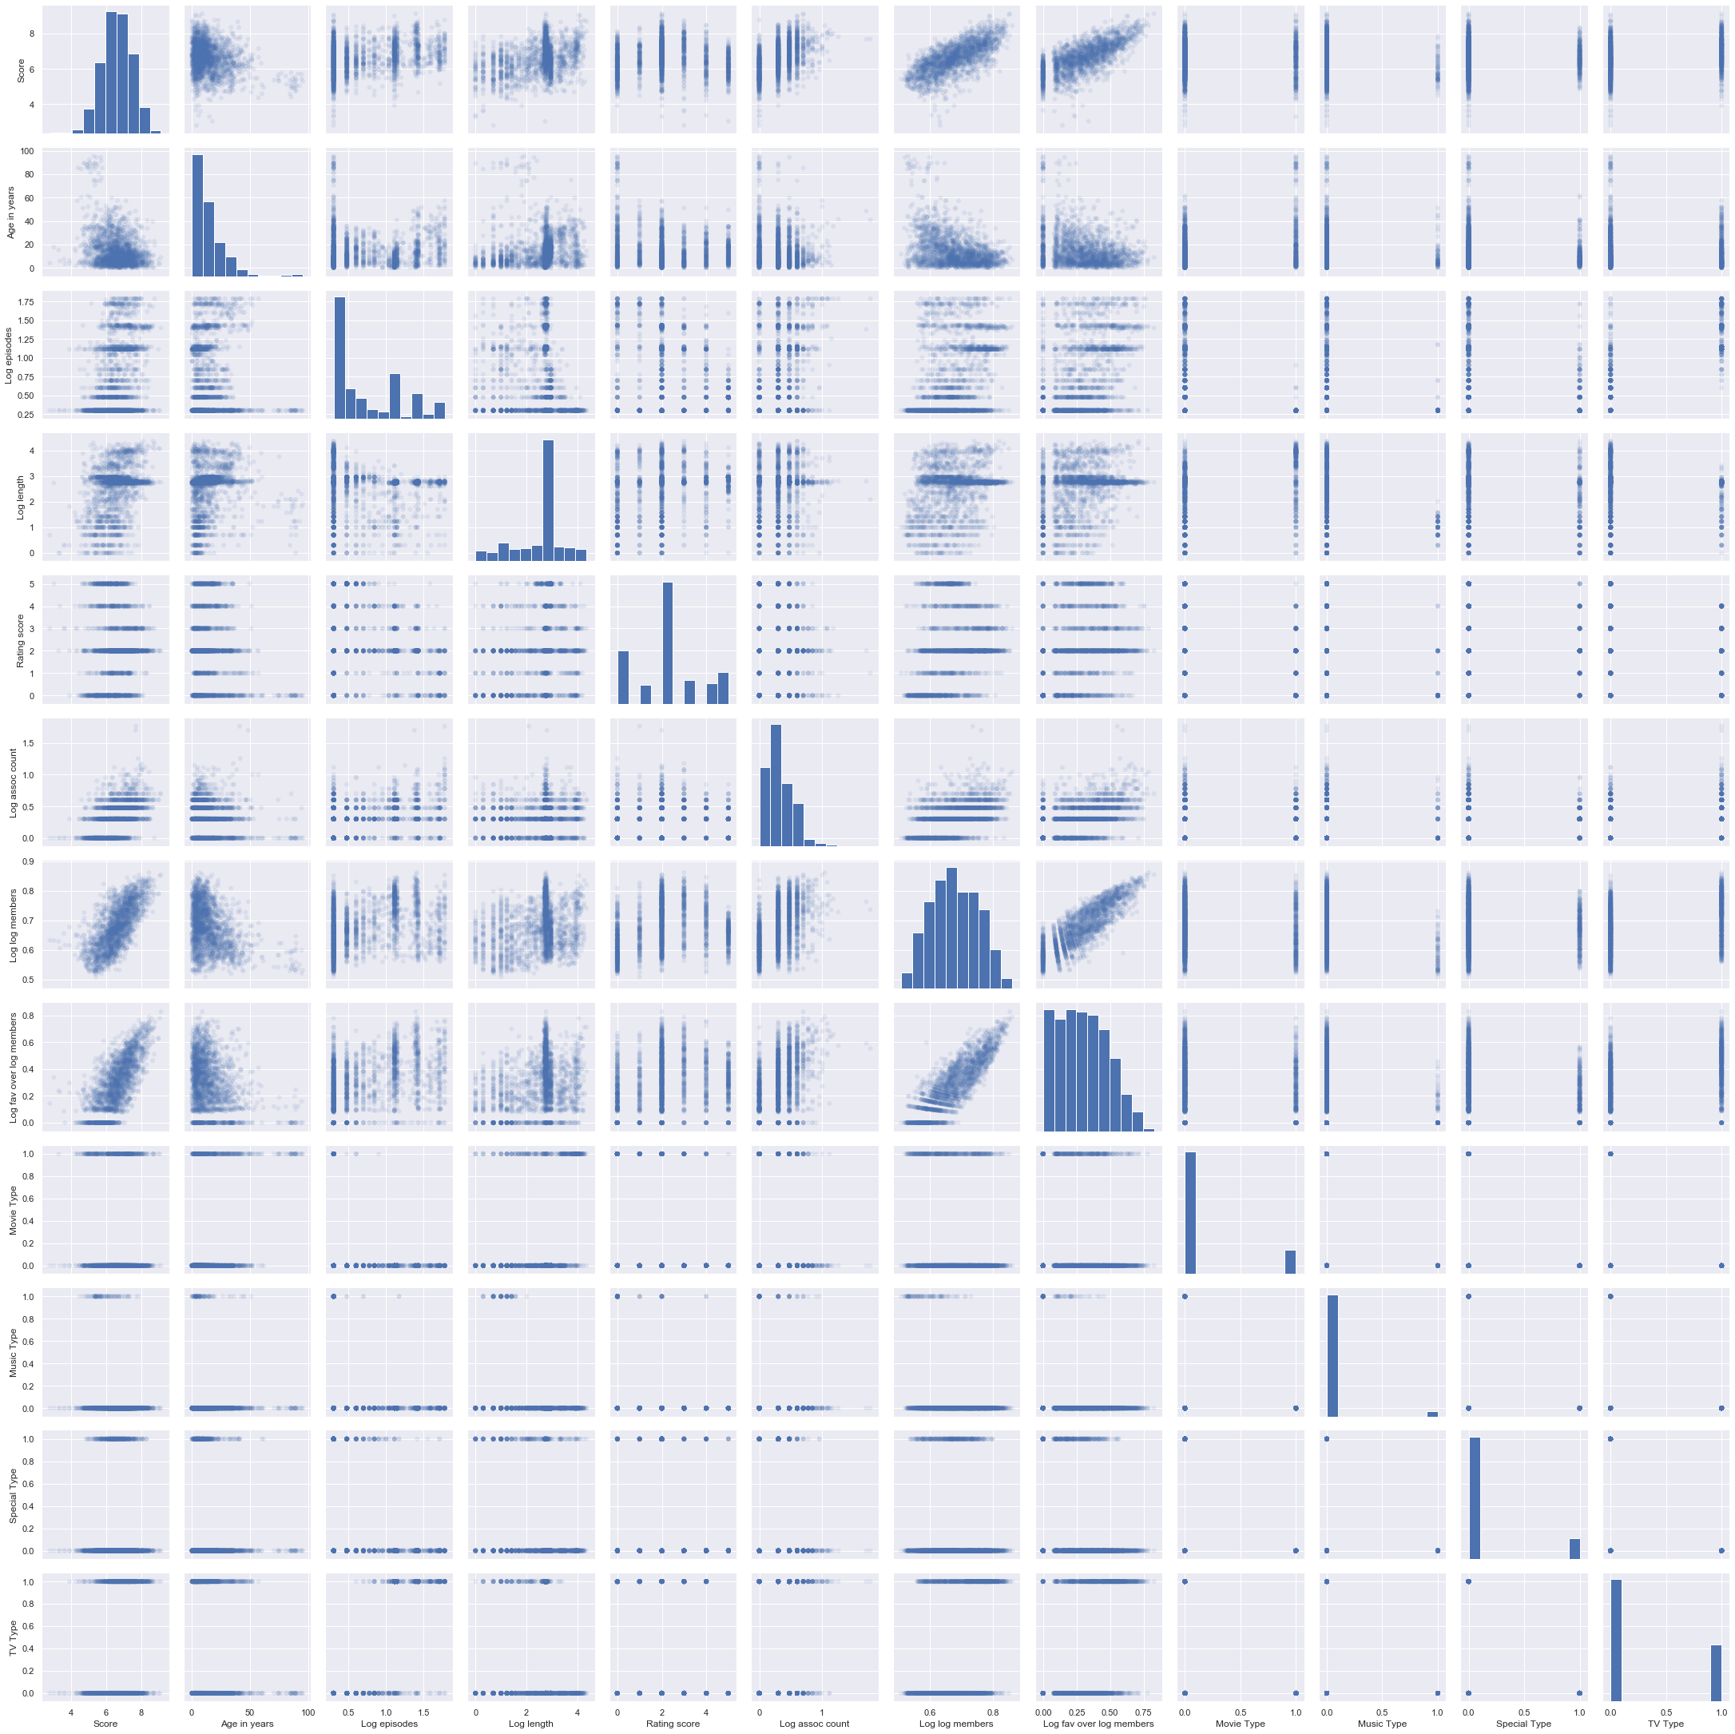
Pair plot of final features

Slide 42
Model selection
Appendix D

Slide 43
Linear regression

Slide 44
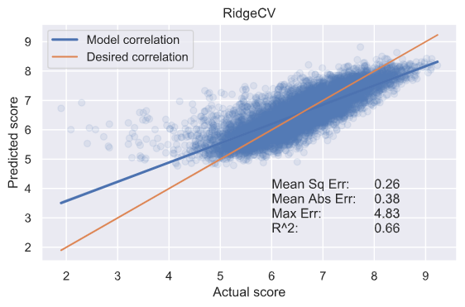
Ridge

Slide 45
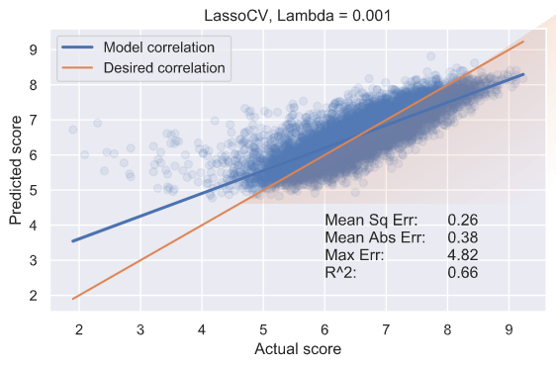
LASSO (final model)

Slide 46
Parameters of final model
Rank | Features | Model weight | Value range | Adjusted weight
1 | Log fav over log members | 2.49568043 | 0 to ~0.83 | ~2.08
2 | Parent story count | 0.27729451 | 0 to 6 | ~1.66
3 | Prequel count | 0.19961581 | 0 to 6 | ~1.20
4 | Log length | 0.2348392 | 0 to ~4.35 | ~1.02
5 | Rating score | -0.10105888 | 0 to 5 | ~0.5
6 | Log log members | 1.22897642 | ~0.51 to ~0.86 | ~0.43
7 | Log associated count | 0.260553 | 0 to ~1.57 | ~0.37
8 | Log age | -0.166226 | ~-0.08 to ~2.02 | ~0.35
9 | Special type | 0.28196419 | 0 or 1 | ~0.28
10 | Log genre count | 0.20748342 | ~0.3 to ~1.5 | ~0.25
11 | Music type | 0.22612855 | 0 or 1 | ~0.23
Model selected: LASSO
Lambda selected: 0.001
Adjusted weight = |Model weight| / Value range

Slide 47
Exploratory Data Analysis Episode count and duration by type of anime
Appendix E

Slide 48
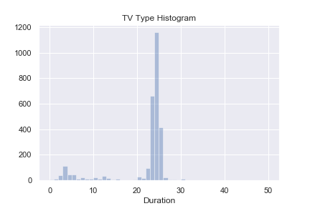
TV: Duration
Most TV anime episodes last for 20-25 minutes
A small proportion last for 3-6 minutes
At least one outlier lasts for up to 50 minutes

Slide 49
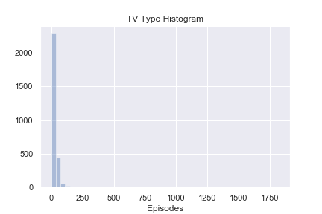
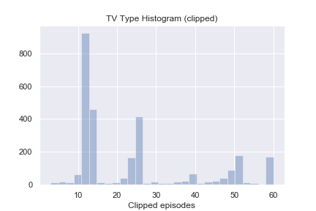
TV: Episodes
Most TV anime are ~13 episodes long, which is the length of an anime season. Other peaks correspond to 2, 3 and 4 seasons
A small minority of TV anime have more than 60 episodes, ranging all the way to ~1750 episodes

Slide 50
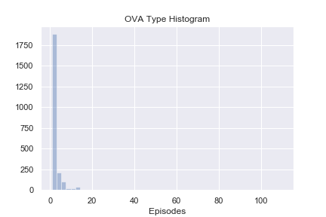
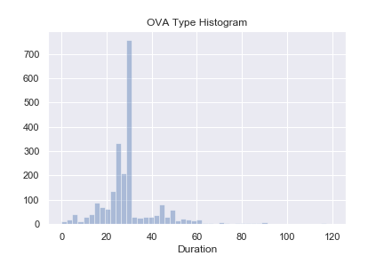
OVA: Duration and episodes
Most OVAs have 1-2 episodes, but some outliers have > 100 episodes
Majority of OVAs last for ~25-30 minutes, with a few outliers lasting > 60 minutes (up to 120 minutes)

Slide 51
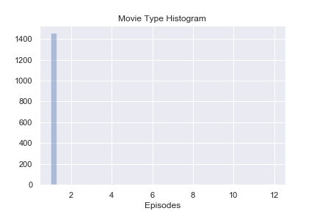
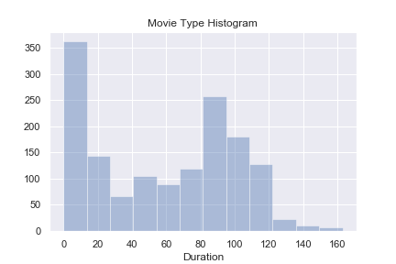
Movies: Duration and episodes
Most movies have 1 episode
Significant number of very-short-form movies (<10 minutes), others cluster around 80-120 minutes in duration

Slide 52
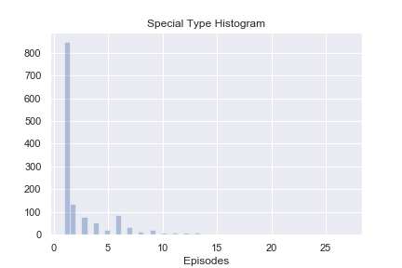
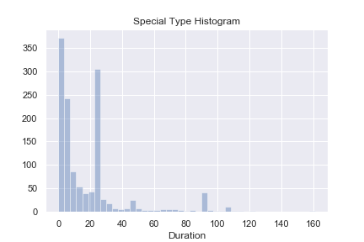
Special: Duration and episodes
Most anime specials have 1-2 episodes, but outliers can have up to 25 episodes
The two most common durations for anime specials are <10 minutes and 23-25 minutes, with most specials lasting < 30 minutes

Slide 53
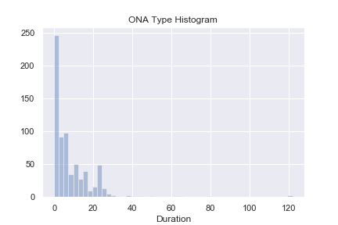
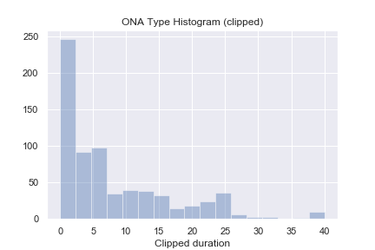
ONA: Duration
Majority of ONAs last for ~ 1 minute
Most last for <25 minutes

Slide 54
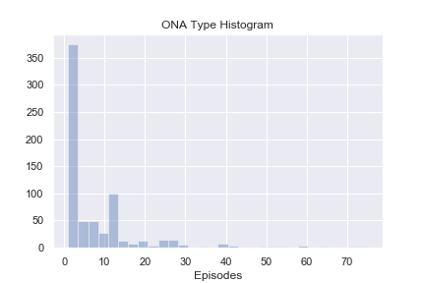
ONA: Episodes
Majority of ONAs have 1 episode, most have <13 episodes
Outliers have up to 70 episodes

Slide 55
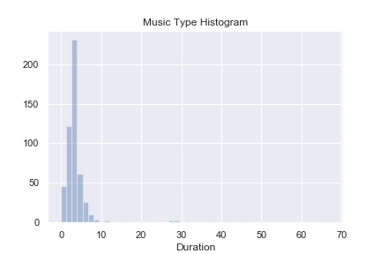
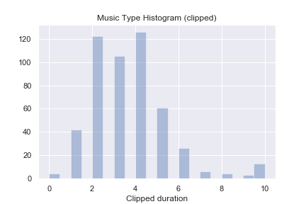
Music: Duration
Most music anime last for < 6 minutes
Could be considered extended music videos
Some outliers go up to 70 minutes

Slide 56
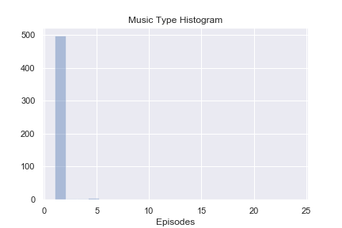
Music: Episodes
Almost all music anime have 1 episode

